Slide 1

What is Classroom Connect?
Classroom Connect is a social media platform whereby students from all over the world can share their scholarly experiences.
Classroom Connect helps students get informed and prepared for the next stages of their academic careers by connecting them with like-minded students and alumni.
Classroom Connect allows students to become more confident about what educational paths to take and create a passionate generation

Slide 2
Mission Statement & Objective
To bridge the gap between students around the world, facilitate their academic journey, empower them to make the best decision for their careers, and build the future they desire.
Develop a platform to enable past, present, and future students to connect and share their post-secondary experiences, enriching one another with helpful information.
Establish a bond between users like high school students, undergraduate, and graduate students.
Provide clarification with respect to university admission requirements, international requirements, and transfer credits.
Share information about anticipated course materials, pre-requisites, and classroom workload.
Offer career assistance to internships, future job opportunities and expected work environment.
Provide clarification in regards to the list of activities to get involved in, school logistics, and academic atmosphere.

Slide 3
Classroom Connect Use Cases
Students can interact with alumni and other students from their current and/or target schools. This provides a platform to raise questions, get answers and grow their network
Students will be able to load their personal, work and course related experience to the application for the benefit of other users
Students can upload posts, comment on posts, send personal messages and upvote the most helpful posts
Users are able to view the profiles of alumnis who enrolled into their target schools and also look at the standardized test requirements for each program
Students can view alumni outcomes filtered by the program or the university. This will allow them to get a better view of their career progression before deciding on a school/program
Students will be able to search users based on their specific interests and/or awards to seek very specific and tailored guidance

Slide 4
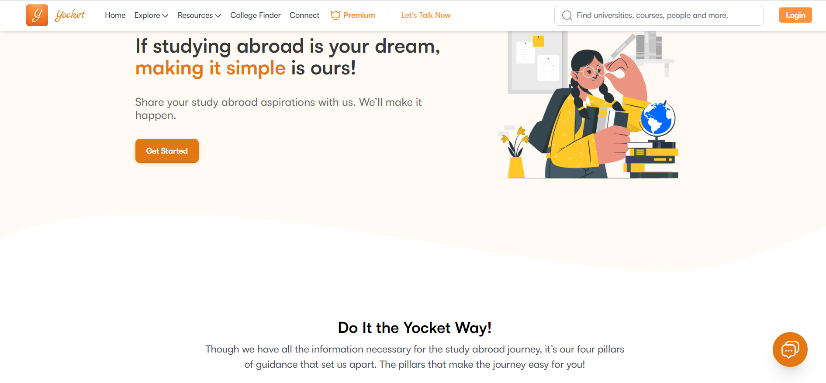
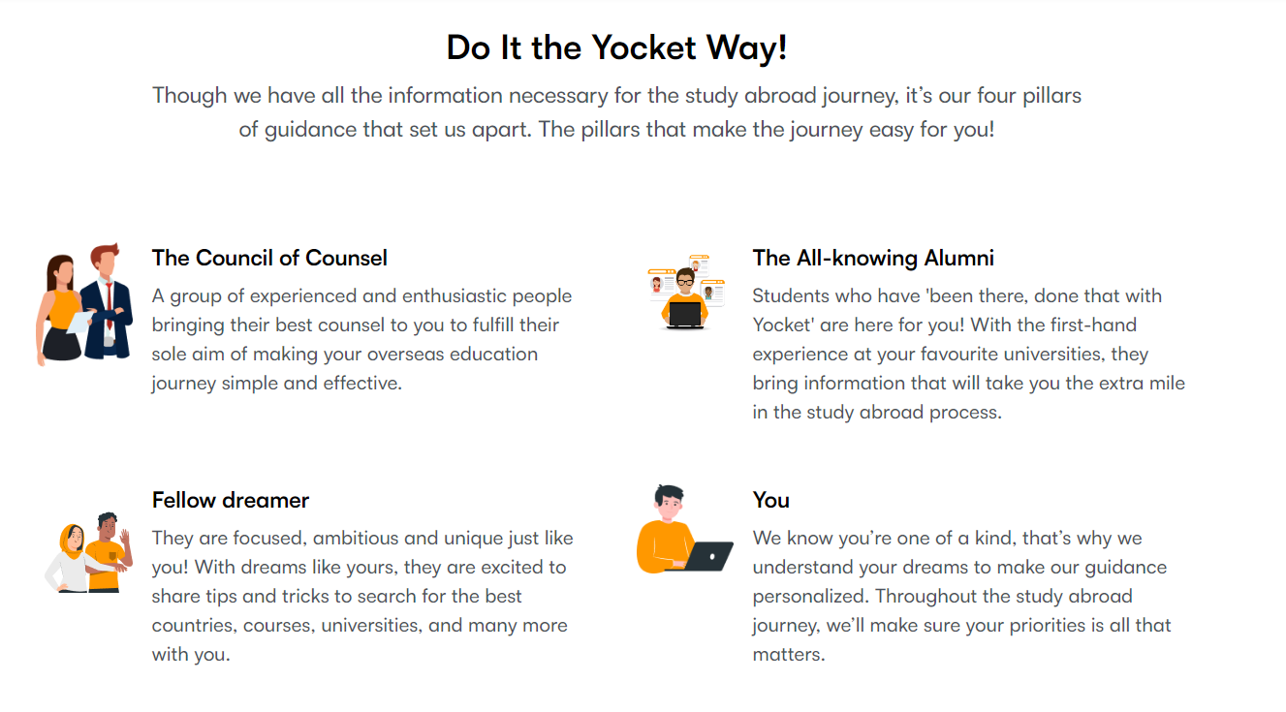
Website Snapshots
https://yocket.com/
Allowing students stay Classroom Connected!

Slide 5
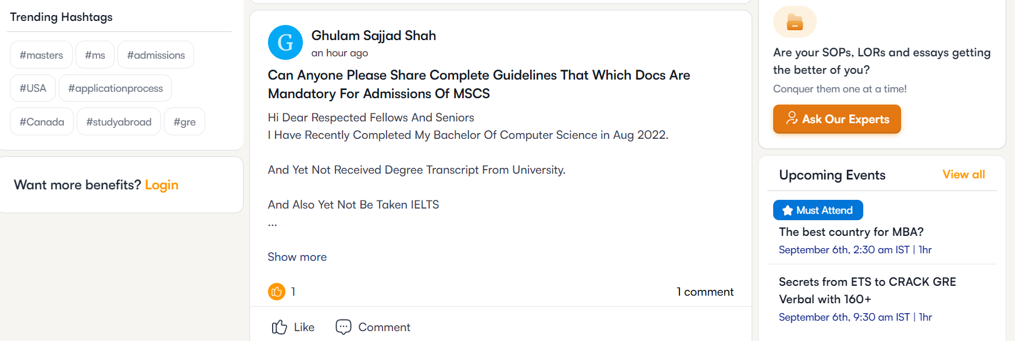
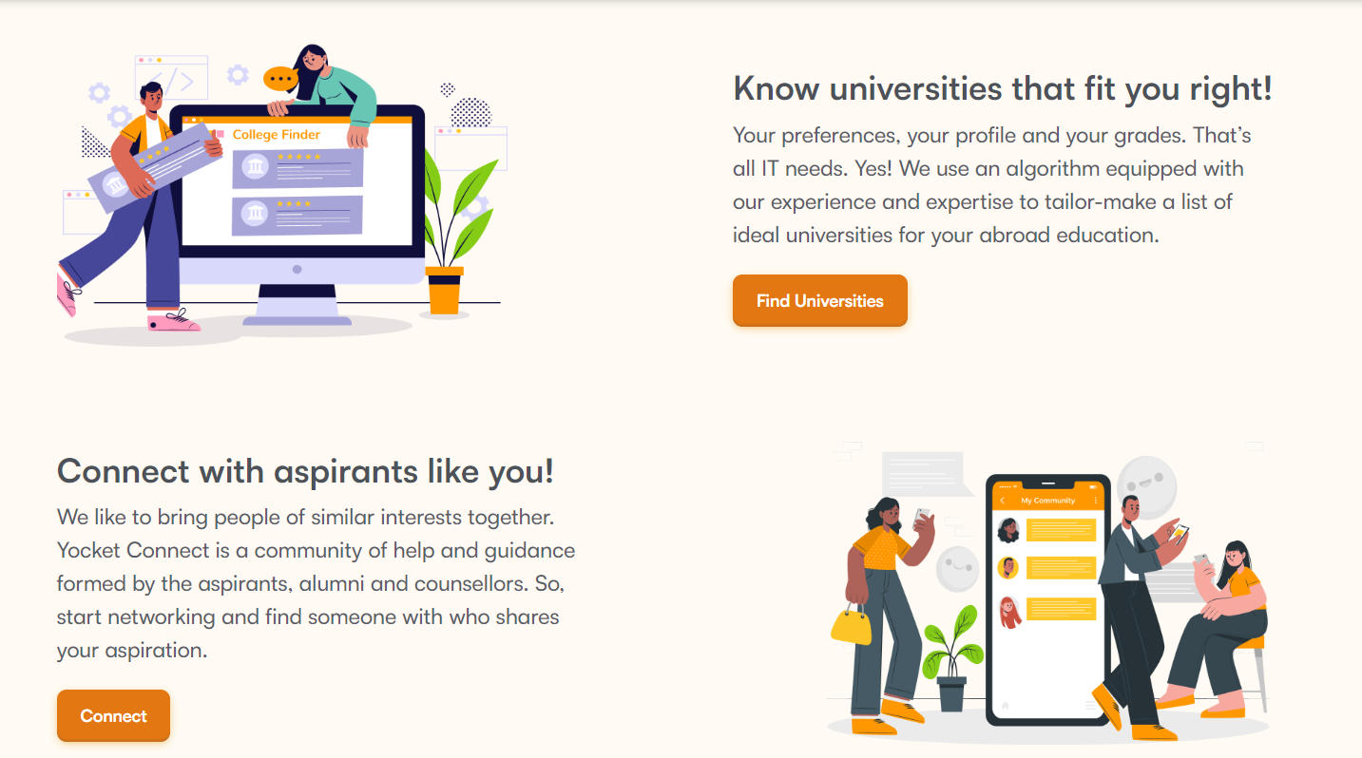
Website Snapshots
Allowing students stay Classroom Connected!

Slide 6
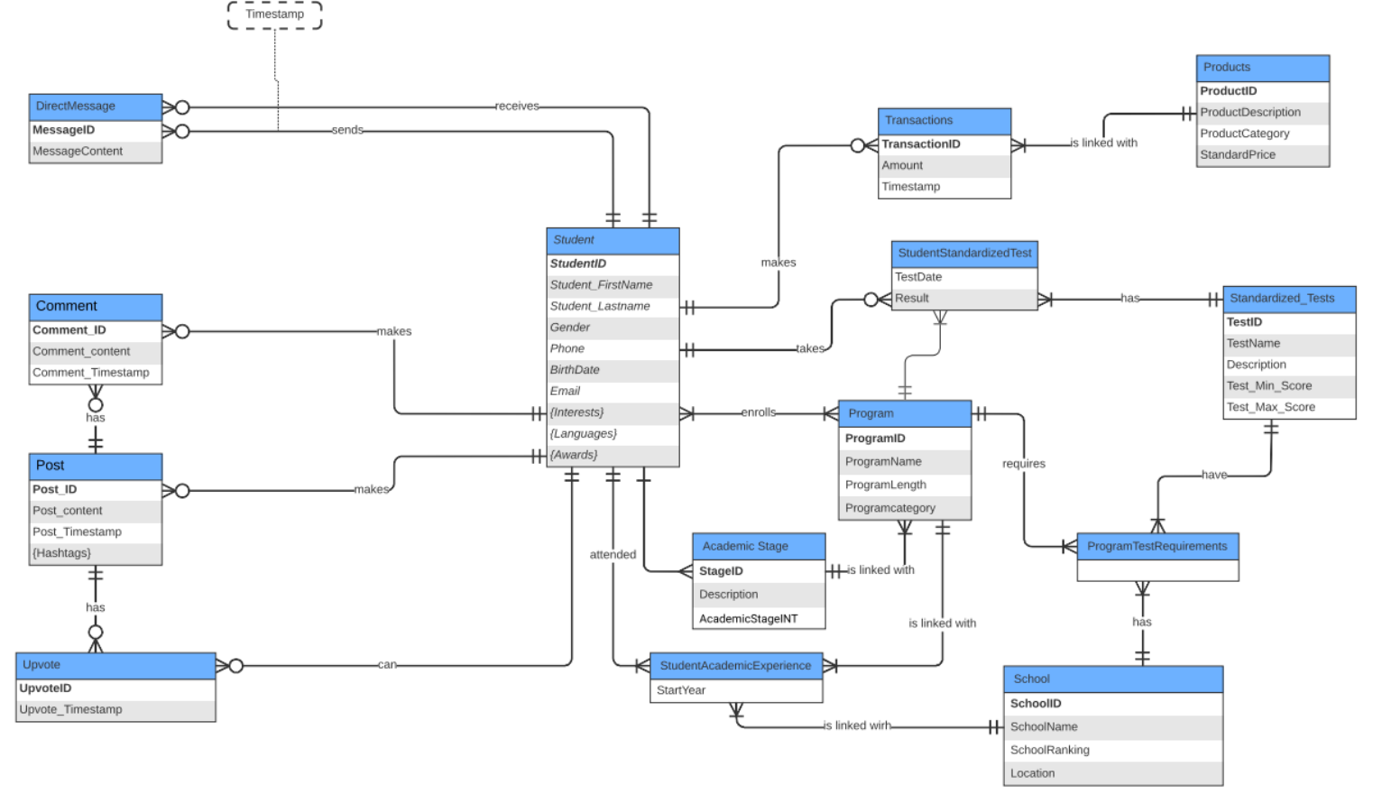
Entity Relationship Diagram (ERD)

Slide 7
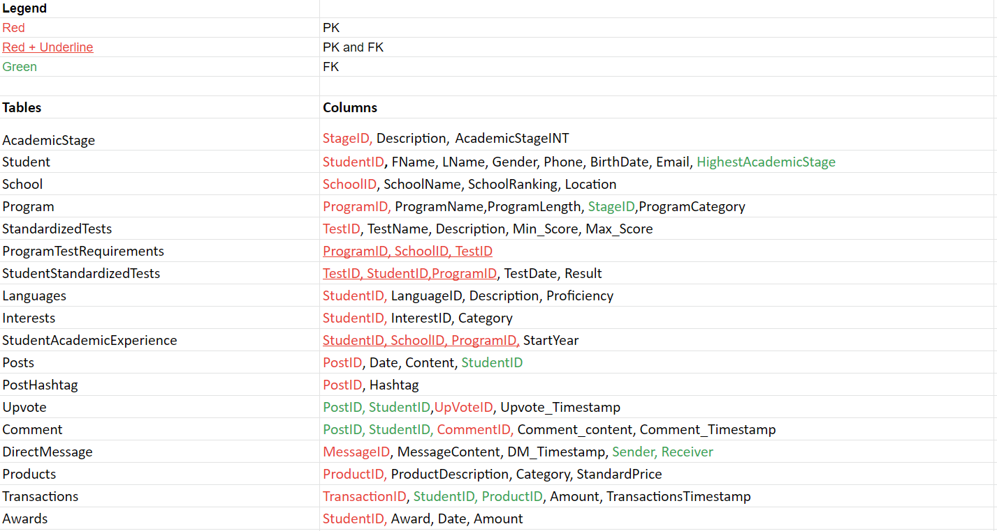
Relational Schema

Slide 8
Entity Dictionary
Entity Name | Description | Aliases | Occurrences
Student | Course information about the content | Student | One student can have many relationships with several of the other entities
Academic Stage | Contains information about students academic stage. | Academic_Stage | One academic stage must have at least one program and at least one student.
School | Contains information about students' school name, school ranking, and school location. | School | One school must offer at least one program. At least one school must be attended by at least one student.
Program | Contains information about program ID, program name and program length | Program | Each program must have a standardized test and offer one program. A school must offer at least one program
Transactions | Contains information about the amount of the transaction as well as the date. | Transactions | One student can make many transactions (or none)
Products | Contains information about the products linked with the transaction, the product description, category, and price. | Program | One product can be linked with at least 1 transaction

Slide 9
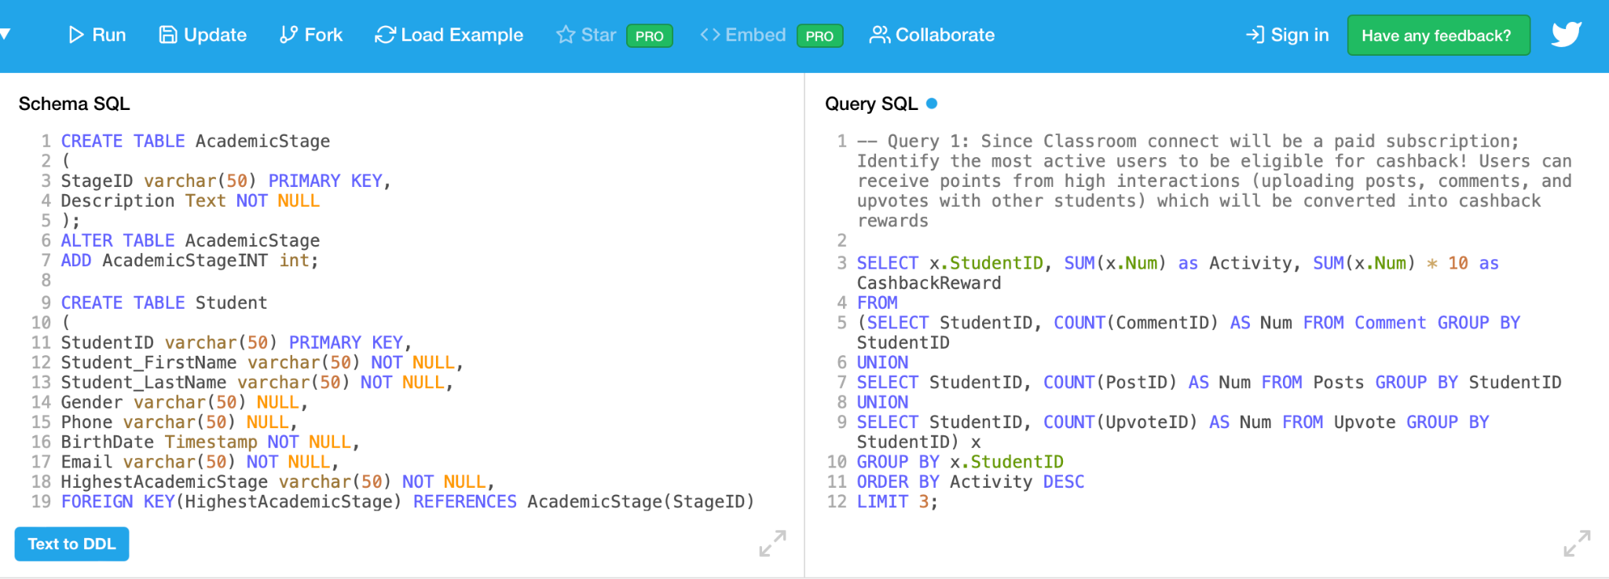
Final Database
https://www.db-fiddle.com/f/mfeh8mkhEHNoAzcUSjs1z8/14

Slide 10
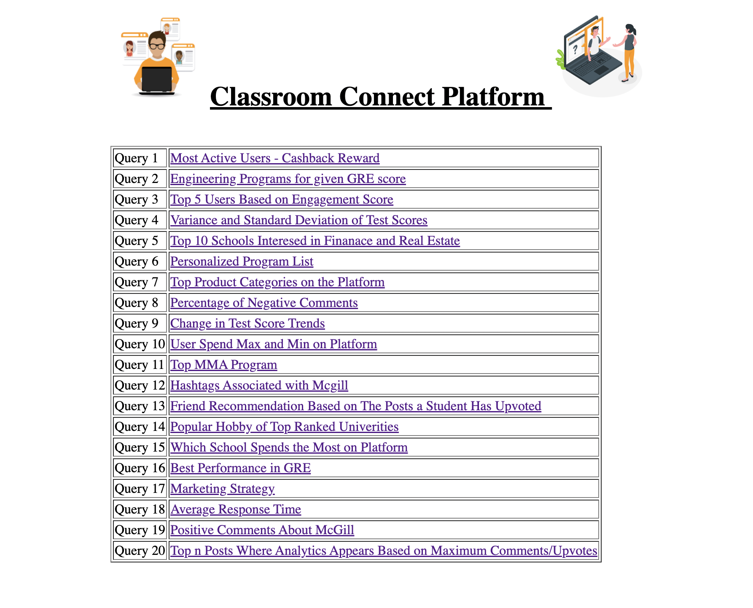
Final Website
http://admissionshelpdbms.epizy.com/final.html

Slide 11
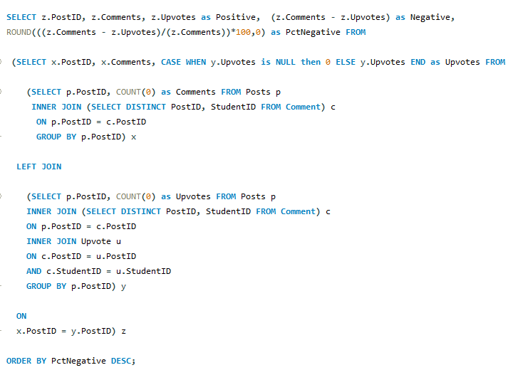
Challenging Queries
Calculate the percentage of negative comments on all the posts. Negative comments are described as comments where a user comments but does not upvote. This will quantity how much of the content on Classroom Connect is useful to users

Slide 12
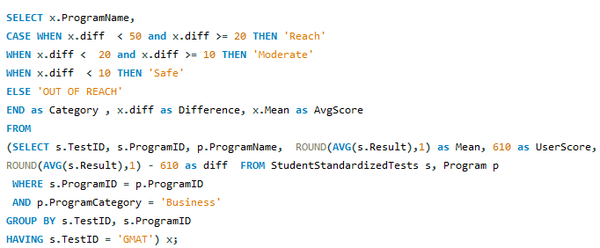
Challenging Queries
A user has purchased a ‘personalized ranking’ list from your platform. This is a ranking of business programs the user is likely to be admitted to based on that user’s GMAT score (610). The likelihood of program admittance is categorized by ‘‘safety’, ‘reach’ and ‘moderate’. This allows students to have a better ideas of what their chances in being admitted to a specific program

Slide 13

Challenges
No prior website to reference from: Since it is a new application, the team had to brainstorm and be creative on creating and linking entities together
Data integration and quality problem: A common issue stemmed from teammates using different applications like MySQL. some queries would return an error since it is case sensitive whereas MySQL wasn’t. Therefore, this process required extensive cleaning and filtering the data
Database access concerns: Everyone installed MySQL Workbench and joined a cloud database instead of using their local machine to collaborate effectively
Explaining challenging queries to the team to ensure everyone understood their part

Slide 14

Classroom Connect Business Potential
Ideas
Rewards
1) Universities start paying for marketing advertisements on the platform
2) Classroom connect can be used by professors to study their next work experiences
3) Universities subscribing to sell items. For instance, “McGill sweatshirts” to boost social media awareness and grab students’ attention
1) Generate income for developers
and provides a broader list of universities for users to apply for
2) Higher ranking of professors, since a professor can have a better understanding of the workplace and relevant courses
3) Boosting income for developers and ability to branch out

Slide 15
Lessons Learnt
The importance of adding comments in your queries, which enables others to quickly understand your queries
As a team of beginners in MySQL, we realized how we subconsciously applied the concept of Normalization when breaking down the entities. We realized its importance and made more sense to apply it when Prof. Animesh explained it.
Even if MySQL is not case sensitive, it is always a good practice to type statements like; “SELECT”, in upper case letters to enhance readability of your queries.
Following up on the above-mentioned comment, it is always a good practice to practice indenting for subqueries.

